Slide 1
Co-design Group Project C
“The Game of Mancala”
Dolgii Alexander, Guselnikova Alina, Medvedev Valdemar

Slide 2
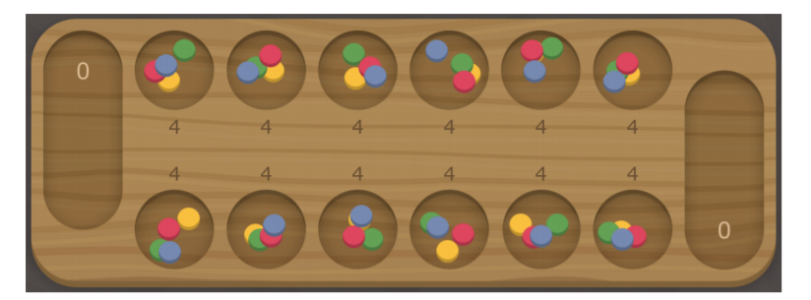
Introduction to the rules
1. Two players play the game facing each other. A player’s holes are in front of the player and the player’s mancala is to his or her right. Initially four seeds are placed in each hole. That amounts to 48 seeds in total. (They could be the same or different colours, a mixture of seeds and pebbles –– it does not matter.) Players take turns to make a move.
2. The move consists in taking all the seeds out of one of the non empty holes that belong to the player and spreading them anticlockwise. One seed is dropped in each hole or the player’s mancala on the way, but the opponent’s mancala is bypassed.

Slide 3
Introduction to the rules_2
3. [Capture rule] If the last seed of a move drops in the player’s own empty hole and the opposite hole is nonempty, that seed and all the seeds from the opposite hole are captured and transferred to the player’s mancala.
4. [Repeat rule] If the last seed of a move drops in the player’s mancala the player makes another move. The game stops when one of the players has no seeds/can’t make a move. If their mancala has 24 seeds, it is a draw, more: a win, less: a loss.

Slide 4
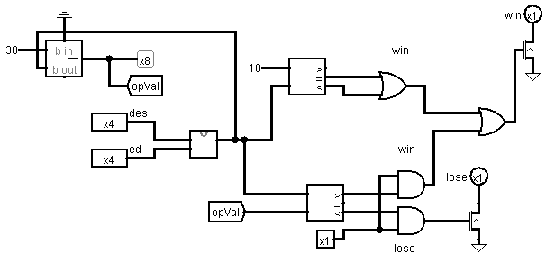
Interesting circuits (Win lose chip)
Notes:
The easiest way to understand that game is over is to create a special chip for it, We have got only to conditions to win - if in all holes 0 and in main hole more than a half of 48 balls OR in our main hole more than 24 balls (that mean that opponent has less than 24 in sum because if in main hole more than 24 and in other holes we haven’t got zero player\computer has more than a half of all field balls)

Slide 5
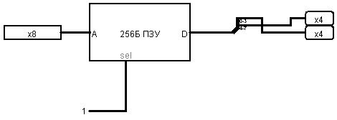
Interesting circuits (Bin to bcd converter)
Notes:
We use a bcd format for display a data because it is only way to show binary data in decimal format. We haven’t created a big logic scheme except of it we use ROM.

Slide 6
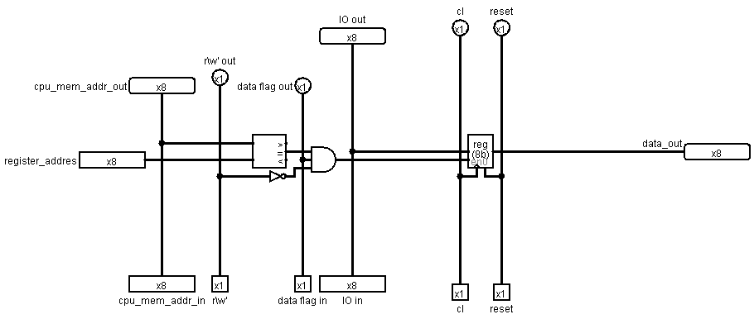
Interesting circuits (Ext register)
Notes:
This is one of the main schemes. If processor writes to memory in specific address it understands that and saving it to own register that can be read by other logical parts. For example if we gives for register address input 0x00 and after that writes by processor data in RAM on 0x00 addr 24 we can get 24 from data out output

Slide 7

Difficulties
Notes:
Our program more than 255 bytes. That’s why we divided the program into 5 parts. Every part located in specific bank.

Slide 8
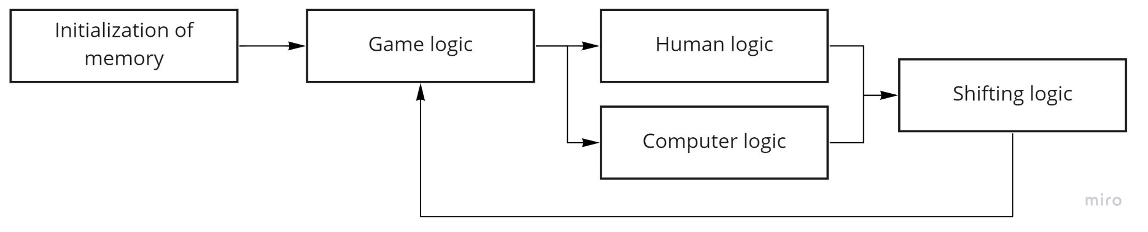
Bank scheme

Slide 9

Link
Github: https://github.com/AnarCom/cdm-8-mankala

